Slide 1
Introduction to SQL Joins

Slide 2
What are SQL Joins?
A JOIN clause is used to combine rows from two or more tables, based on a related column between them.
Essential for working with relational databases where data is normalized across multiple tables.

Slide 3
Key Characteristics:
Combining Tables: Joins allow merging rows from two or more tables based on a condition (typically a common key).
Types of Joins:
INNER JOIN: Returns only the rows with matching values in both tables.
LEFT JOIN (or LEFT OUTER JOIN): Returns all rows from the left table and matched rows from the right table.
RIGHT JOIN (or RIGHT OUTER JOIN): Returns all rows from the right table and matched rows from the left table.
FULL JOIN (or FULL OUTER JOIN): Returns all rows when there is a match in one of the tables.
CROSS JOIN: Combines every row of the first table with every row of the second table.
Relational Data Integrity: Joins maintain relationships between tables based on foreign keys or shared columns.
Efficient Data Retrieval: Joins allow you to pull related data from multiple tables in a single query.

Slide 4
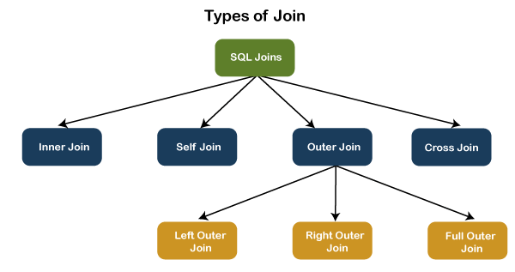

Slide 5
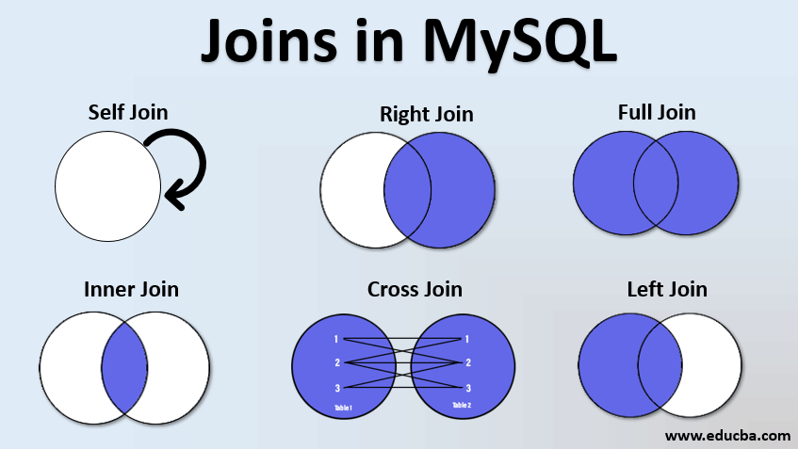

Slide 6
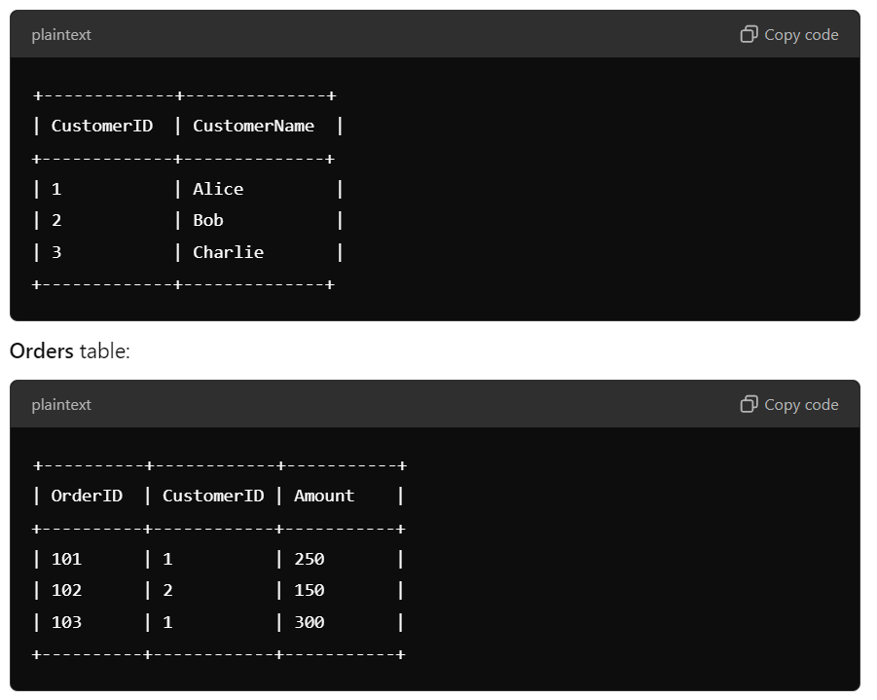
Detailed Example with and Without Joins
Scenario: Customer Orders in an E-commerce System
You have two tables:
Customers table:

Slide 7
Detailed Example with and Without Joins
Scenario: Customer Orders in an E-commerce System
You have two tables:
Orders table:

Slide 8
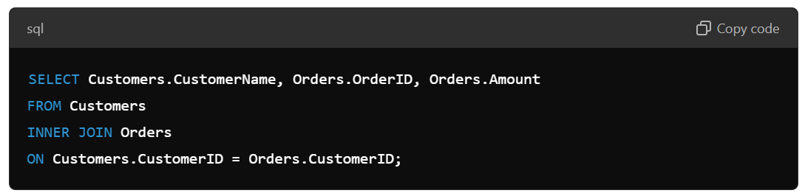
Using Joins :
If we use a JOIN, say an INNER JOIN, to get all orders along with customer names, the SQL query will look like this:

Slide 9
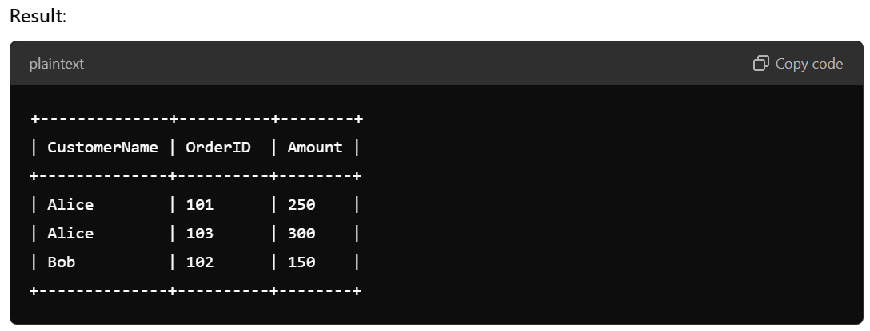
Using Joins :
If we use a JOIN, say an INNER JOIN, to get all orders along with customer names, the SQL query will look like this:

Slide 10
What Happens:
JOIN fetches only the records that have a matching CustomerID in both tables.
It provides a consolidated view of customers who placed orders, with details of their respective orders.

Slide 11
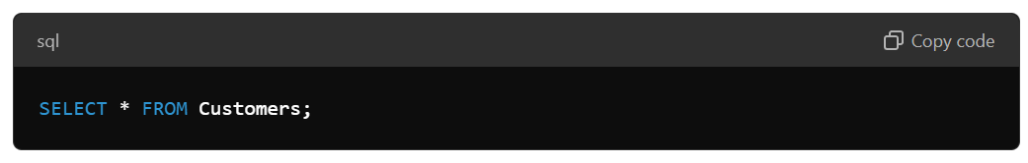
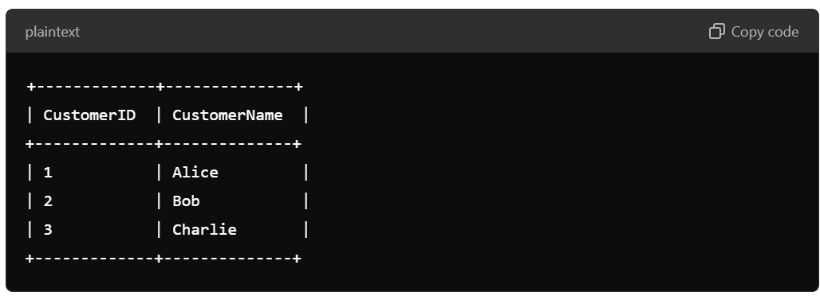
Without Using Joins
If you don’t use a JOIN, you will have to query each table separately to get information from each:
First, you query the Customers table:
Result:

Slide 12
What Happens:
Without JOINs, you must manually compare or merge the data from both tables, which is inefficient and prone to errors.
For instance, to find which customer placed which order, you need to manually match CustomerID in both tables.
This approach becomes extremely cumbersome and inefficient when working with large databases.

Slide 13
Benefits of Using Joins:
Single Query: Retrieves all the data you need from multiple tables in a single query, making it faster and easier.
Efficiency: Avoids the need for manual matching between tables, which can be slow and error-prone.
Data Integrity: Ensures that data from related tables is correctly and consistently pulled together based on the key relationships.

Slide 14
Real-World Examples Where Joins Are Used:
E-commerce Systems: Combining customer, orders, and product details to generate reports such as "which customers bought what products."
Healthcare Management: Joining patient records, doctor visits, and prescriptions for generating patient histories and medical reports.
School/University Databases: Joining student details with their enrolled courses, grades, and attendance records.
Financial Systems: Joining transactions, customer details, and account information for generating financial summaries and fraud detection reports.

Slide 15
INNER JOIN

Slide 16
What is Inner Join?
Definition:
An INNER JOIN returns only the rows that have matching values in both tables.
It excludes rows that do not have a match in either table.
Key Characteristics:
Only returns records where there is a match between the two tables.
If no match is found, the row is excluded from the result.
Most commonly used type of join.

Slide 17
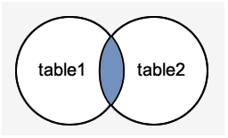
Real-World Example
In an Employee Management System, an INNER JOIN can be used to fetch the details of employees and the projects they are assigned to, but only for employees currently working on a project.

Slide 18
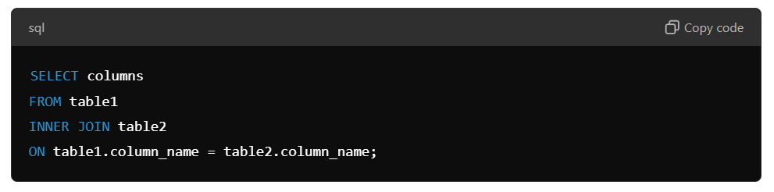
INNER JOIN Syntax:
An INNER JOIN returns only the rows that have matching values in both tables.

Slide 19
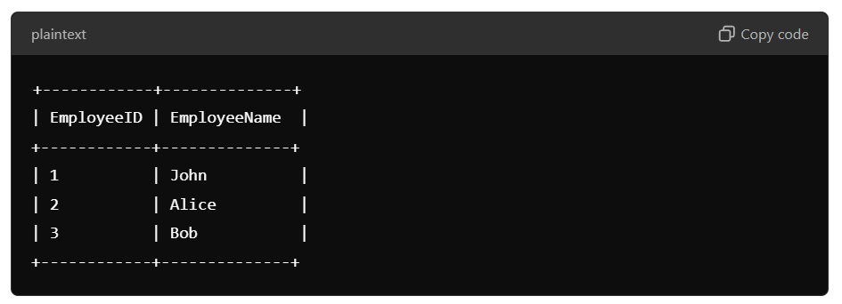
Detailed Example:
With INNER JOIN:
Suppose we have two tables:
Employees:

Slide 20
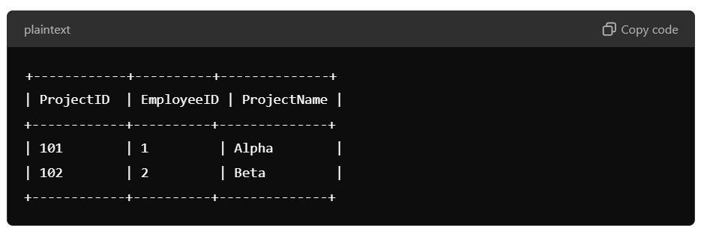
Detailed Example:
With INNER JOIN:
Suppose we have two tables:
2. Projects:

Slide 21
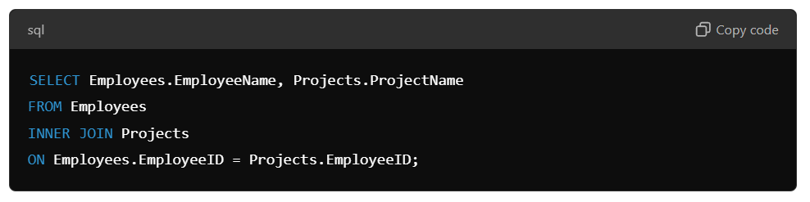
SQL Query using INNER JOIN:

Slide 22
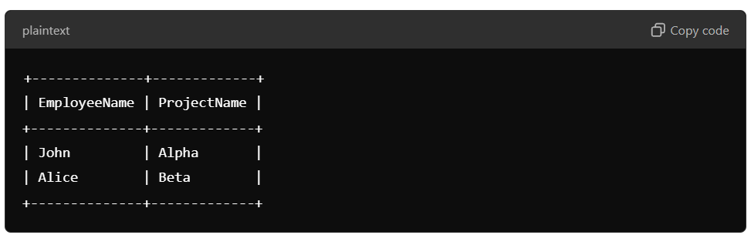
Result:

Slide 23
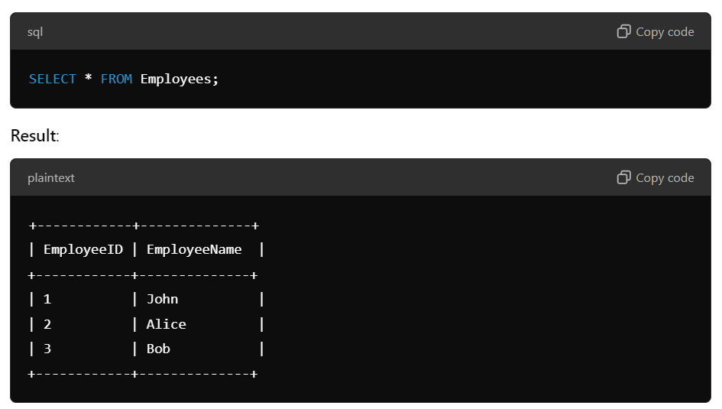
Without INNER JOIN:
Without a JOIN, you'd query each table separately:
Employees Table Query:

Slide 24
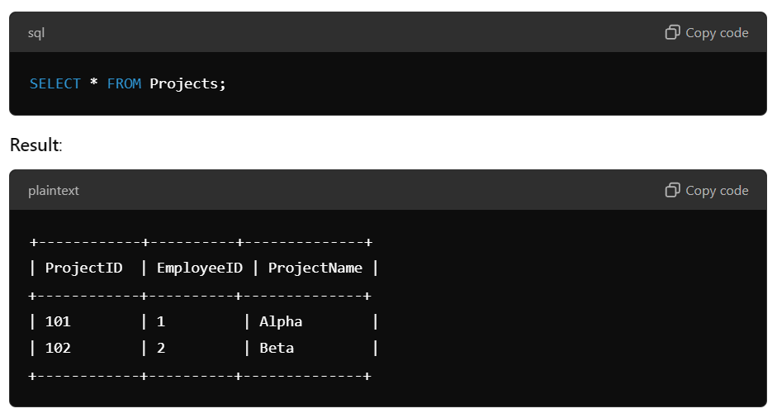
Without INNER JOIN:
Without a JOIN, you'd query each table separately:
Projects Table Query:
Without the INNER JOIN, there’s no easy way to directly see which employee is working on which project without manually matching the EmployeeID from both tables.

Slide 25
Thank You

Slide 26
LEFT JOIN

Slide 27
What is Left Join?
Definition:
A LEFT JOIN returns all records from the left table (the table mentioned first in the query), and the matched records from the right table. If there is no match, NULL values are returned for the columns from the right table.
Key Characteristics:
Returns all rows from the left table, with matching rows from the right table.
If there’s no match, NULL values are filled for the columns from the right table.
It is useful when we want all data from one table and matched data from the other.

Slide 28
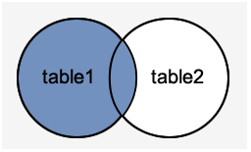
Real-World Example:
In a Student-Course Enrollment System, a LEFT JOIN can be used to retrieve all students along with their enrolled courses, even if a student is not enrolled in any course.

Slide 29
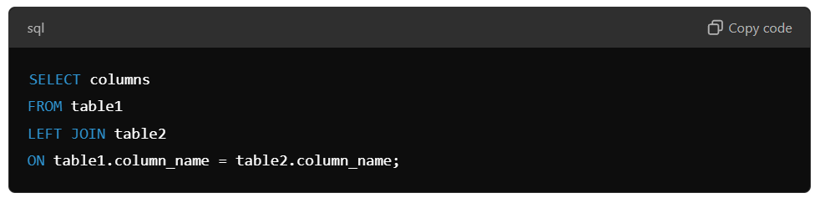
LEFT JOIN Syntax:
A LEFT JOIN returns all the rows from the left table and the matched rows from the right table. If there is no match, NULL values are returned from the right table.

Slide 30
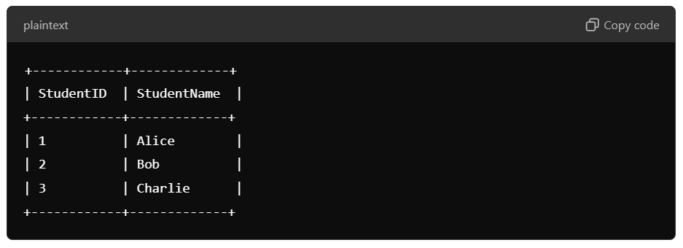
Detailed Example:
With LEFT JOIN:
Suppose we have two tables:
Students:

Slide 31
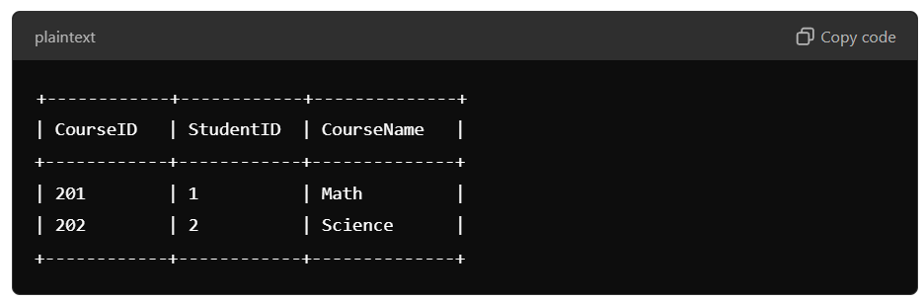
Detailed Example:
With LEFT JOIN:
Suppose we have two tables:
2. Courses:

Slide 32
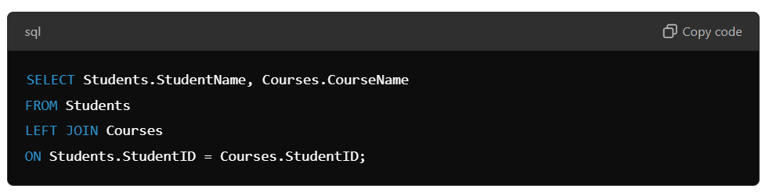
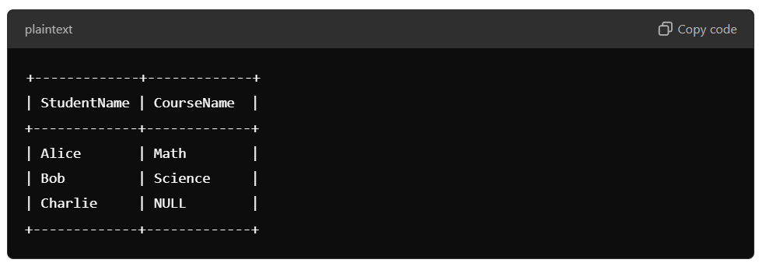
SQL Query using LEFT JOIN:
Result:
Notice that Charlie is included even though they don’t have a course, and the CourseName is NULL for them.

Slide 33
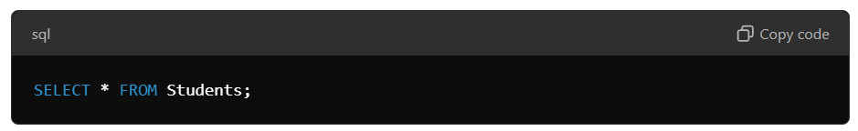
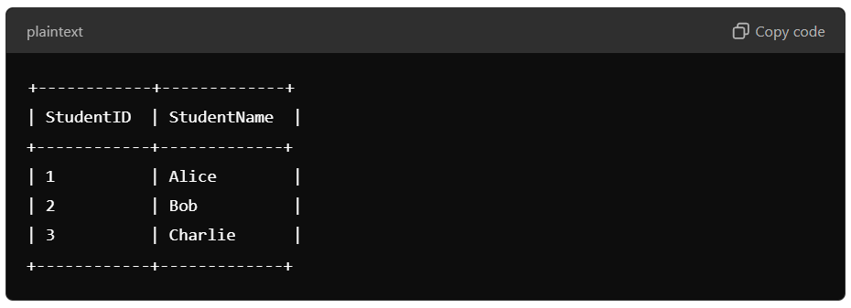
Without LEFT JOIN:
Without the LEFT JOIN, you won’t get the students who are not enrolled in any course:
Students Table Query:
Result:

Slide 34
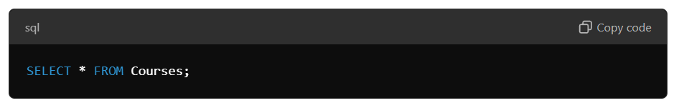
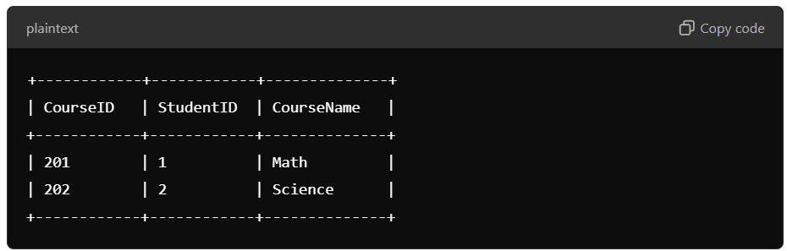
Without LEFT JOIN:
Without the LEFT JOIN, you won’t get the students who are not enrolled in any course:
Courses Table Query:
Result:
Without the LEFT JOIN, we can’t see which students are not enrolled in any courses.

Slide 35
Thank You

